Slide 1
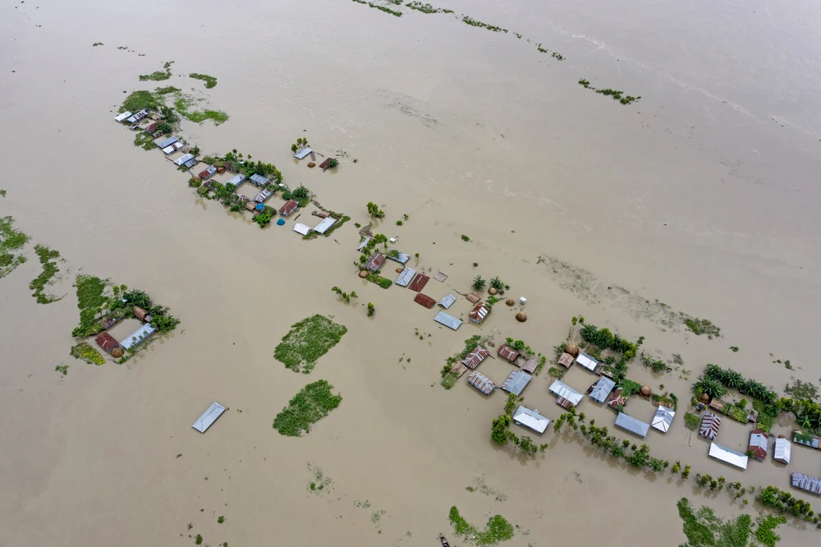
Large-Scale Optimization of Last-Mile Drone Delivery Network: Column Generation to Solve a VRP-D Optimizing emergency responses: developing operations research tools for Flood response in Bangladesh
Date: Sep 02, 2024
Notes:
Image source: https://www.thenewhumanitarian.org/photo-feature/2019/07/22/Bangladesh-flood-health-risks

Slide 2
For now, we are focusing on Case Study 1. So, you can skip next few slides and concentrate from Slides 08-14

Slide 3

Research Outline
Introduction
Background
RQ
Method
Proposed methodology
Solution algorithm
Computational Result
Discussion

Slide 4
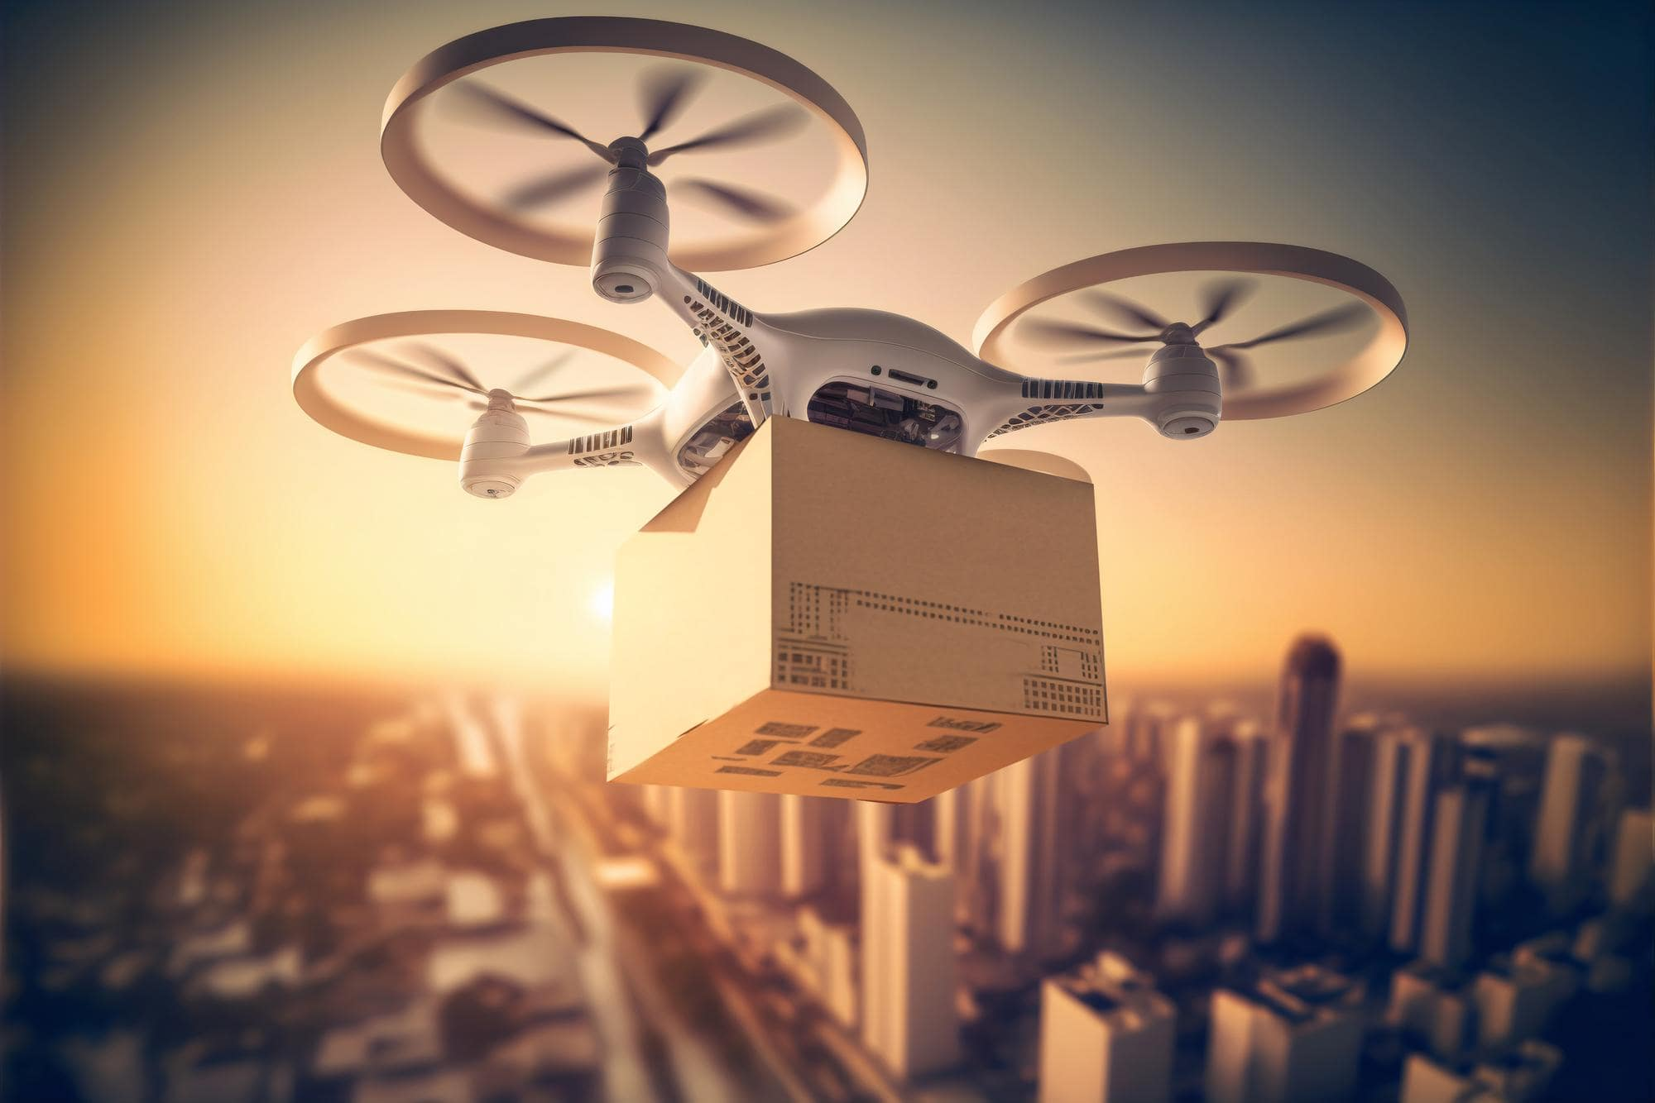
Background & Motivation
Last-mile delivery is the most time-consuming and costly part of the supply chain, making its optimization crucial for competitive advantage.
To meet rising e-commerce demands, logistics companies are turning to innovative solutions like drone delivery to improve efficiency.
This paper addresses the challenges of optimizing large-scale last-mile drone delivery by using a column generation approach to solve the Vehicle Routing Problem with Drone (VRP-D).
Extensive experiments show that the proposed method improves delivery efficiency and reduces costs, offering valuable insights for optimizing last-mile logistics with advanced technologies.
Notes:
Will change the fig later

Slide 5
Research Questions
Model itself
What novel mathematical models can be developed to incorporate multi-modal transportation (e.g., combining trucks, drones, bikes) into the VRP for last-mile delivery?
How can models for drones be adapted to handle dynamic, real-time conditions, such as sudden changes in delivery locations, or unexpected drone failures?
Solution algorithm
How can the pricing problem in column generation be optimized to generate routes more effectively for last-mile delivery?
How can heuristics or metaheuristics be integrated with column generation to improve solution quality for last-mile delivery optimization?
Sensitivity
What are the impacts of various problem parameters (e.g., number of customers, geographic distribution) on the performance of VRP models for last-mile delivery?
What are the trade-offs between solution quality and computational time when using heuristic-based column generation?
What are the impacts of varying problem parameters (e.g., number of deliveries, geographic distribution) on the performance of VRP algorithms in drone delivery?

Slide 6
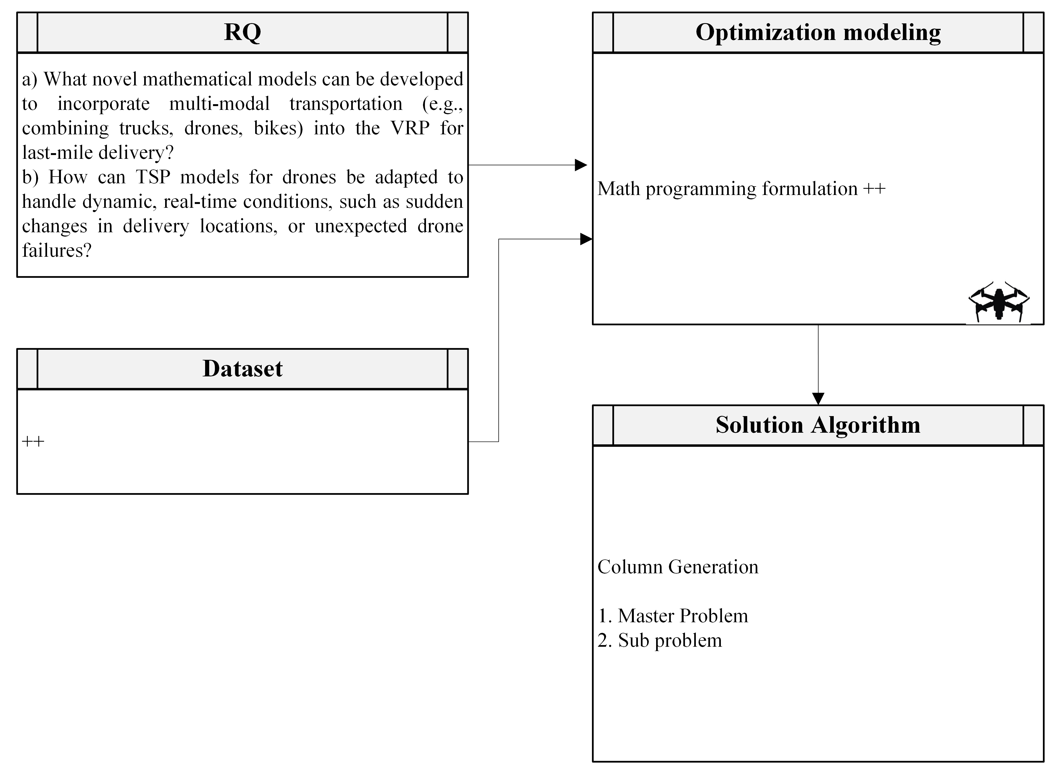
Proposed Method

Slide 7
Solution algorithm
Column Generation ++
Relevance to large-scale optimization??

Slide 8
Case study 1 Optimizing emergency responses: developing operations research tools for Flood response in Bangladesh

Slide 9
Problem Statement
How we can maximize the coverage of shelter points given:
Disrupted road network
Resource constraints
Limited capacity of vehicles
Coverage: delivering reliefs from warehouse to shelters

Slide 10
Data
Cyclone shelter centers geolocation
Road networks in Bangladesh
GIS map of each districts
Population in each district
Warehouse: need to assume
Shelters: capacity, geo-location
Road network: national& regional highway, other roads, disrupted (can we get flood elevation or other info++ Riad)
Demand: resource needed, Location of people
Resource/relief: Quantity and warehouse location

Slide 11
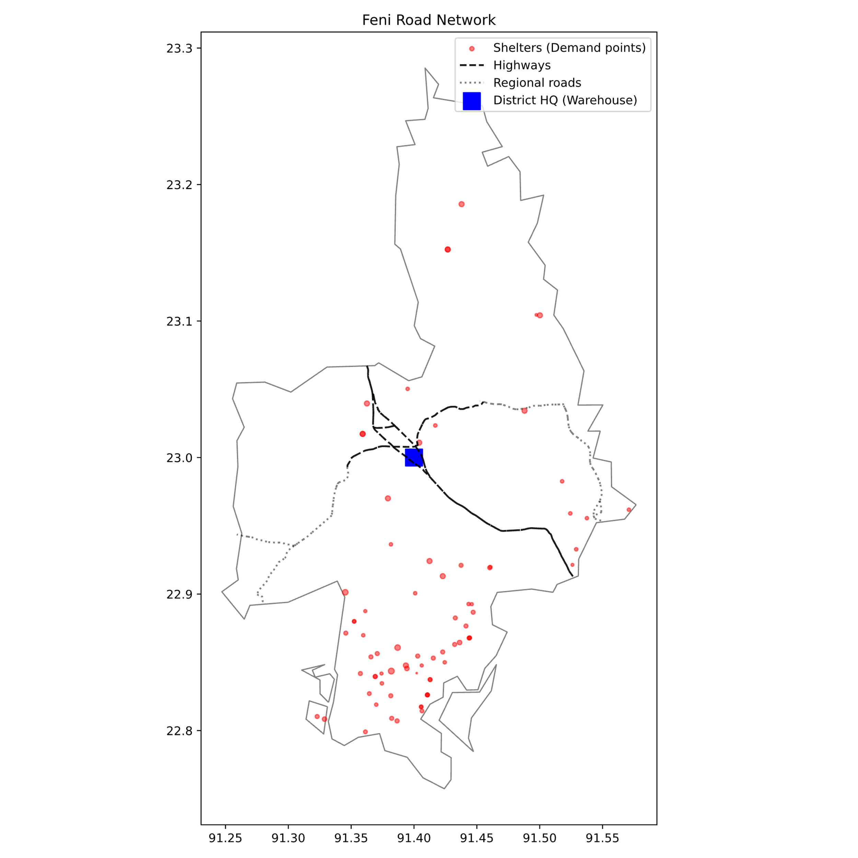
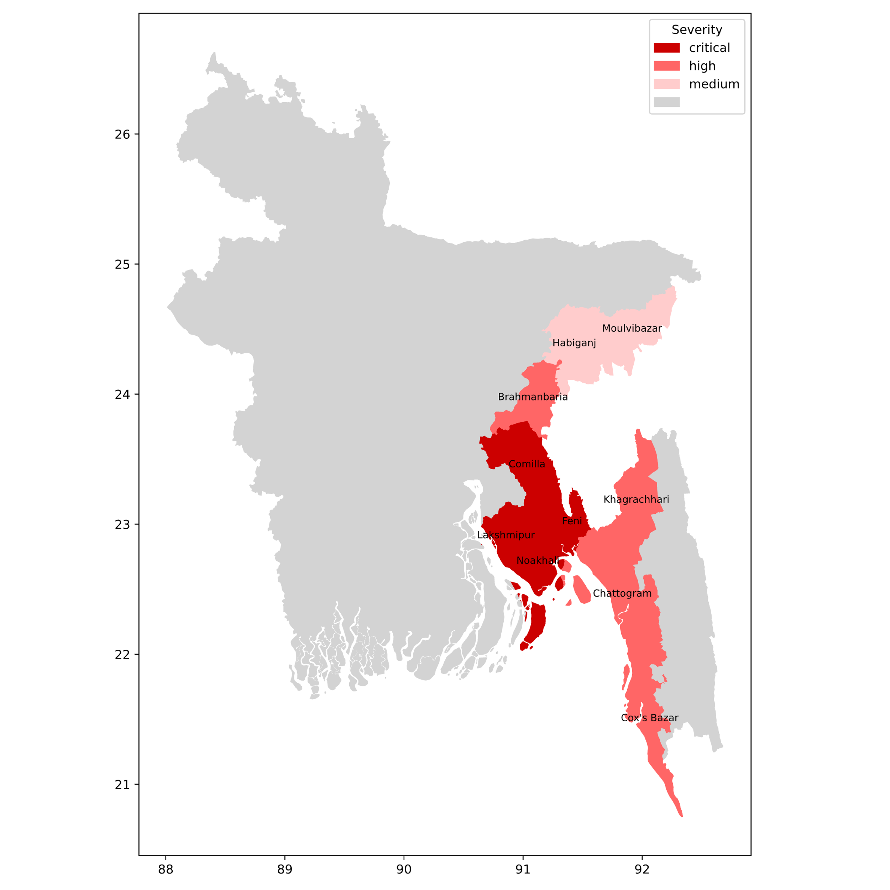
Data Exploration
Notes:
Feni ++ replace background GIS map, add a Warehouse location
http://nsds.bbs.gov.bd/storage/files/1/Publications/PHCensus/Chattaogram/District%20Report%20Feni.pdf

Slide 12
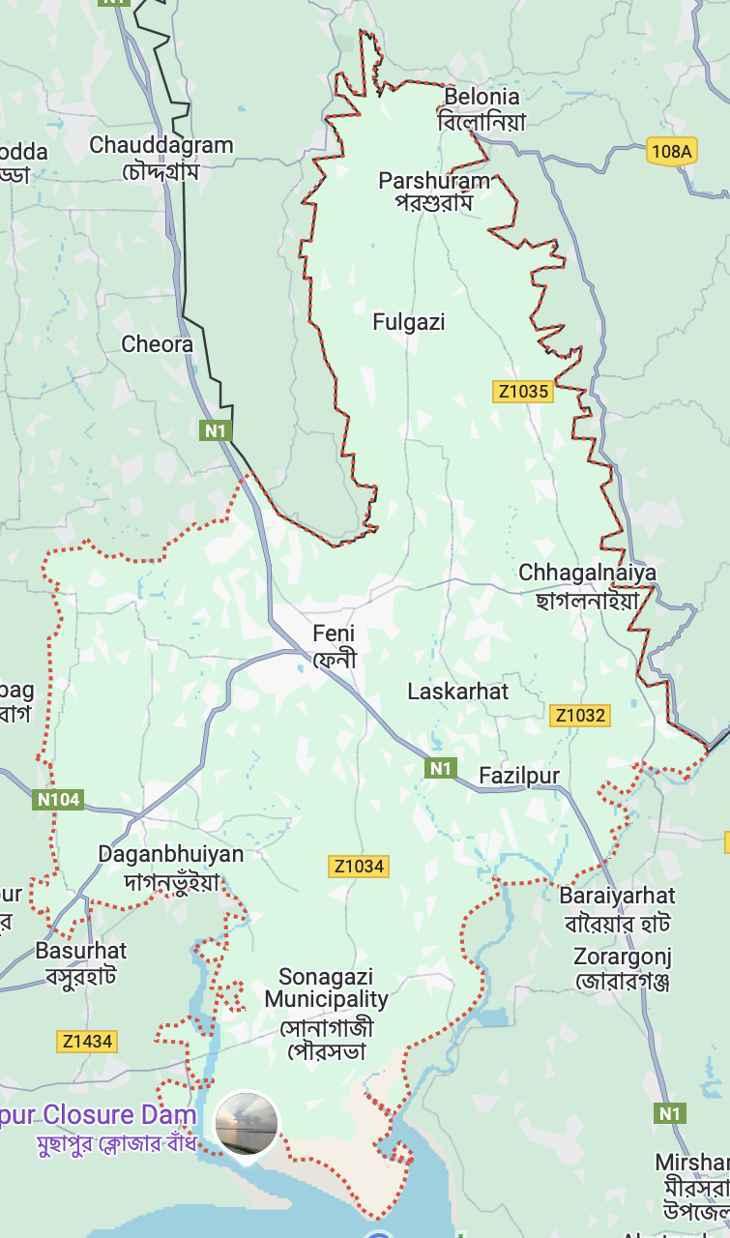
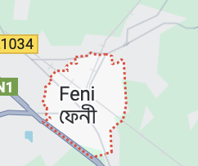
Feni
Total population in Feni 1.6M
Sonagachi (where most shelters are) 0.39M population
0.6M in Feni Sadar (small central region)

Slide 13
Optimization model (VRP’s variant)
Conceptual Model
Objective: maximizing coverage of shelter (demand) points
DV: no. of vehicles (# of drone, helicopter, truck), capacity of these vehicle
Vehicle level: x_ijk, from where to where
Routing level: road selection (disrupted, non-disrupted routes)
Input parameters: packages.
Disrupted vs non-disrupted networks
Constraint
Travel each demand points only once
Capacity constraints: for each vehicle
Travelling distance: helicopter (max coverage), every vehicle (truck refuel), other practical limits
Time-window
Math model

Slide 14
Results
Notes:
One minimal optimized supply chain network

Slide 15
Web app
Main Task for now:
Build the minimalistic online web app (anyone can input these two inputs, and get the GIS map)
Edges of the map should be roads of GIS graph, not straight line, add an animation if possible
Input
Availability (in warehouse) and capacity (of vehicles)
Output
A table
A GIS map
Reference data
25% coverage availability = {'W1': 1500, 'W2': 2000} capacities = {'D1': 1000, 'D2': 2000, 'T1': 1600, 'T2': 2000}
46% coverage availability = {'W1': 1500, 'W2': 20000} capacities = {'D1': 1000, 'D2': 12000, 'T1': 1600, 'T2': 2000}
Notes:
Run the optimization model every time

Slide 16
Computational Result: Dataset
Dataset 1 ( Wu et al., 2024):
Dataset 2 (US Arctic emergency response related VRP): summary of the dataset+

Slide 17
Implementation
Modeling: Python/Pyomo
Solver: CPLEX/Gurobi
Simulation: AnyLogic
Versioning: Github
Packaging: Docker & Streamlit

